Slide 1
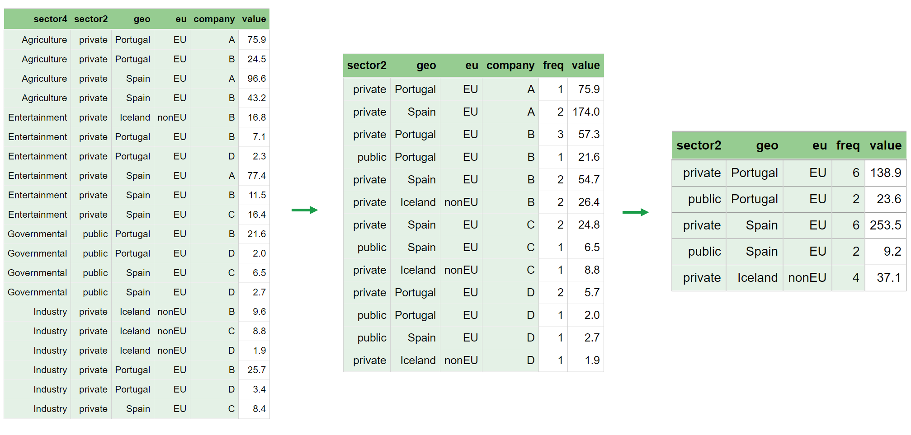
Statistical Disclosure Control (SDC) day 4, part 2
Automatic Aggregation
The Singleton Problem
The So-Called Singleton Problem
weightVar
04.03.2024

Slide 2
Contents
Automatic Aggregation
in magnitude tables
The Singleton Problem
for magnitude tables
The So-Called Singleton Problem
for frequency tables
weightVar
About the parameter named weightVar
Applies to both volume and frequency tables
Tomorrow related topics for frequency tables will be discussed

Slide 3
About automatic aggregation
in magnitude tables

Slide 4
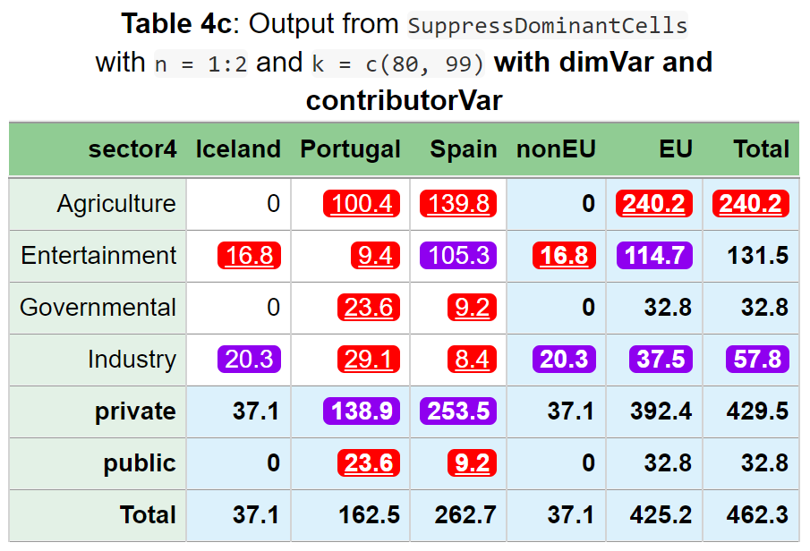
> SuppressDominantCells(data=dataset,
numVar = "value",
dimVar = c("sector4", "sector2", "geo", "eu"),
n = 1:2, k = c(80, 99),
contributorVar = "company")
[preAggregate 20*6->20*7]
[extraAggregate 20*7->10*7] Checking .....
GaussSuppression_numttH: ..................
sector4 geo freq value primary suppressed
1 Total Total 20 462.3 - -
2 Total EU 16 425.2 - -
3 Total nonEU 4 37.1 - -
4 Total Iceland 4 37.1 - -
5 Total Portugal 8 162.5 - -
6 Total Spain 8 262.7 - -
7 private Total 16 429.5 - -
8 private EU 12 392.4 - -
9 private nonEU 4 37.1 - -
10 private Iceland 4 37.1 - -
11 private Portugal 6 138.9 - TRUE
12 private Spain 6 253.5 - TRUE
13 public Total 4 32.8 - -
14 public EU 4 32.8 - -
15 public nonEU 0 0.0 - -
16 public Iceland 0 0.0 - -
17 public Portugal 2 23.6 TRUE TRUE
18 public Spain 2 9.2 TRUE TRUE
19 Agriculture Total 4 240.2 TRUE TRUE
20 Agriculture EU 4 240.2 TRUE TRUE
21 Agriculture nonEU 0 0.0 - -
22 Agriculture Iceland 0 0.0 - -
23 Agriculture Portugal 2 100.4 TRUE TRUE
24 Agriculture Spain 2 139.8 TRUE TRUE
25 Entertainment Total 6 131.5 - -
26 Entertainment EU 5 114.7 - TRUE
27 Entertainment nonEU 1 16.8 TRUE TRUE
28 Entertainment Iceland 1 16.8 TRUE TRUE
29 Entertainment Portugal 2 9.4 TRUE TRUE
30 Entertainment Spain 3 105.3 - TRUE
31 Governmental Total 4 32.8 - -
32 Governmental EU 4 32.8 - -
33 Governmental nonEU 0 0.0 - -
34 Governmental Iceland 0 0.0 - -
35 Governmental Portugal 2 23.6 TRUE TRUE
36 Governmental Spain 2 9.2 TRUE TRUE
37 Industry Total 6 57.8 - TRUE
38 Industry EU 3 37.5 - TRUE
39 Industry nonEU 3 20.3 - TRUE
40 Industry Iceland 3 20.3 - TRUE
41 Industry Portugal 2 29.1 TRUE TRUE
42 Industry Spain 1 8.4 TRUE TRUE
You may have noticed these lines being printed

Slide 5
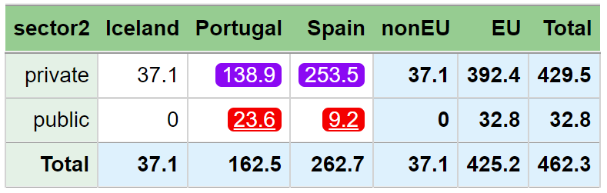
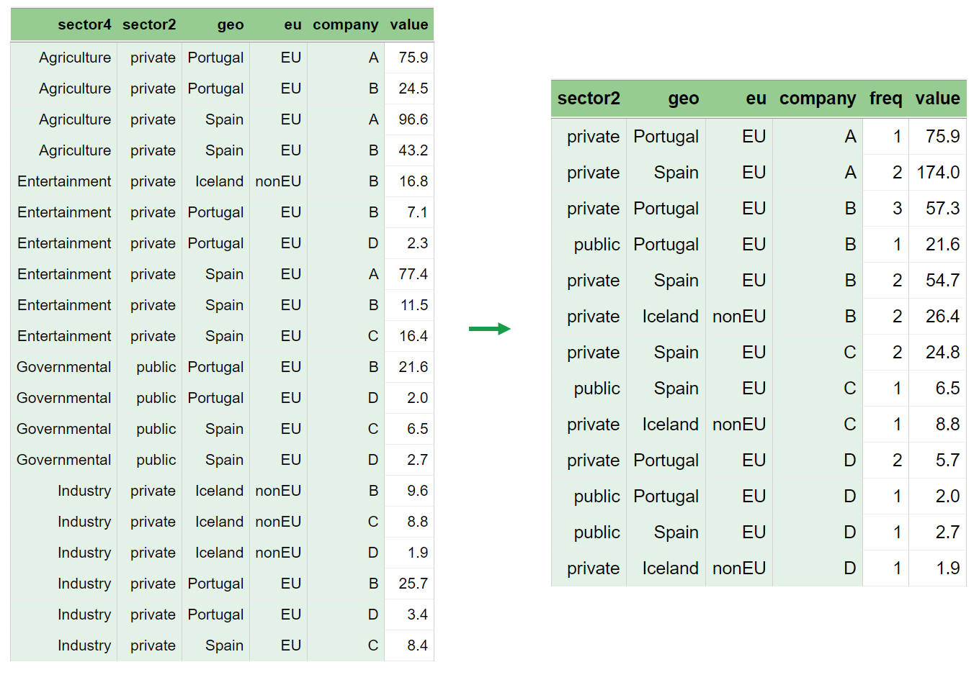
> SuppressDominantCells(data=dataset,
numVar = "value",
dimVar = c("sector2", "geo", "eu"),
n = 1:2, k = c(80, 99),
contributorVar = "company")
[preAggregate 20*6->13*6]
[extraAggregate 13*6->5*6] Checking .....
GaussSuppression_numttH: ............
sector2 geo freq value primary suppressed
1 Total Total 20 462.3 - -
2 Total EU 16 425.2 - -
3 Total nonEU 4 37.1 - -
4 Total Iceland 4 37.1 - -
5 Total Portugal 8 162.5 - -
6 Total Spain 8 262.7 - -
7 private Total 16 429.5 - -
8 private EU 12 392.4 - -
9 private nonEU 4 37.1 - -
10 private Iceland 4 37.1 - -
11 private Portugal 6 138.9 - TRUE
12 private Spain 6 253.5 - TRUE
13 public Total 4 32.8 - -
14 public EU 4 32.8 - -
15 public nonEU 0 0.0 - -
16 public Iceland 0 0.0 - -
17 public Portugal 2 23.6 TRUE TRUE
18 public Spain 2 9.2 TRUE TRUE
The values were changed when dimVar was changed
Here you see what happens

Slide 6
preAggregate
Data is aggregated as much as possible before primary suppression and other similar calculations
A frequency variable is created, which counts the number of rows in the input
Aggregated to the extent that ensures all table variables (dimVar) and all codes in contributorVar are still included
If contributorVar is not included, a “contributor” per row is assumed and preAggregate is not performed.
Then you need to know what you are doing …
Safest to always include contributorVar

Slide 7
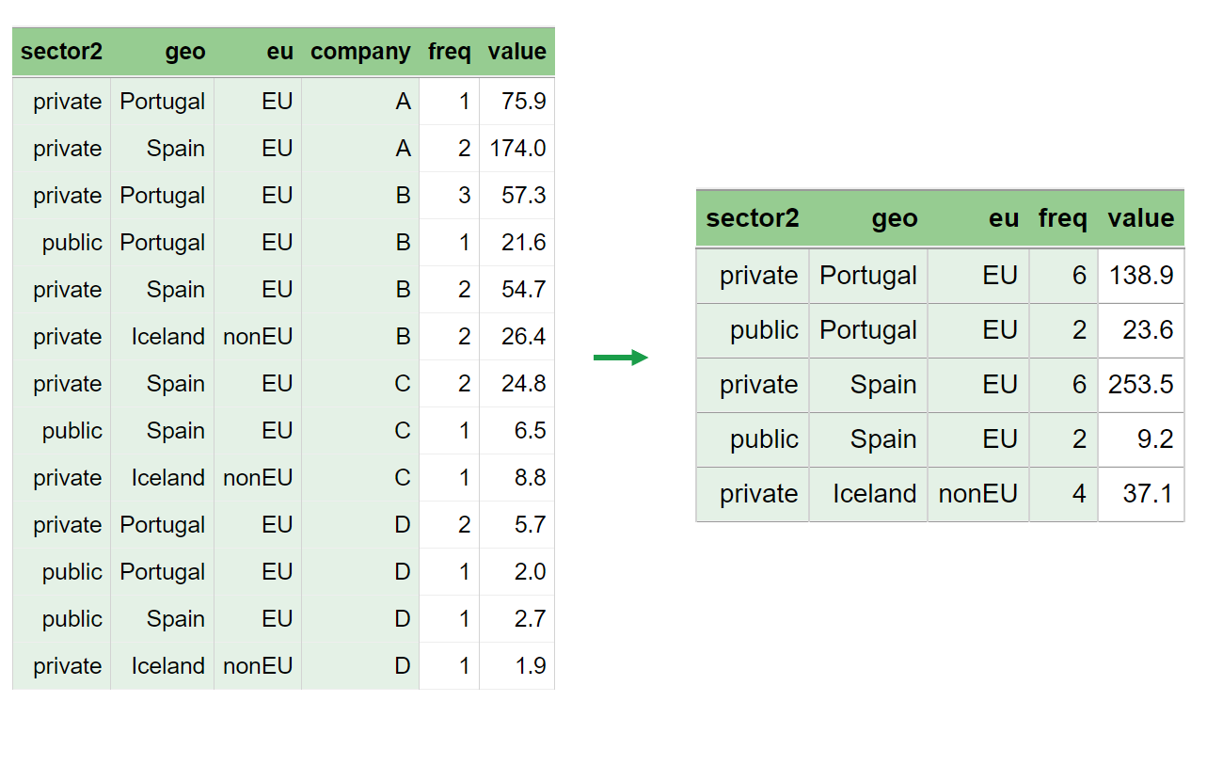

Slide 8
extraAggregate
Data is aggregated as much as possible before running the actual suppression algorithm (Gauss)
Aggregated to the extent that all table variables (dimVar) are still included; contributorVar is no longer needed
Internal variables are created for handling singletons
It's best to trust the automation and not modify this unnecessarily...

Slide 9
The Singleton Problem

Slide 10
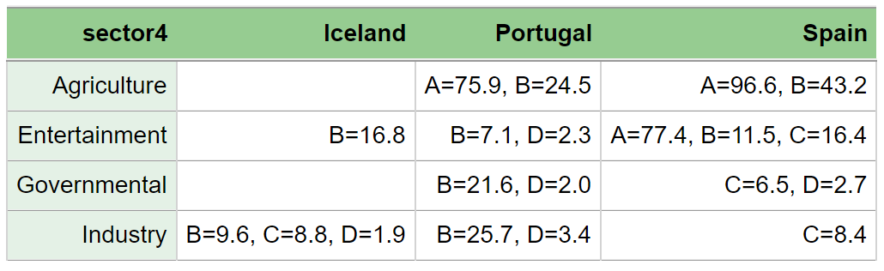
Only a single contributor
Only a single contributor

Slide 11
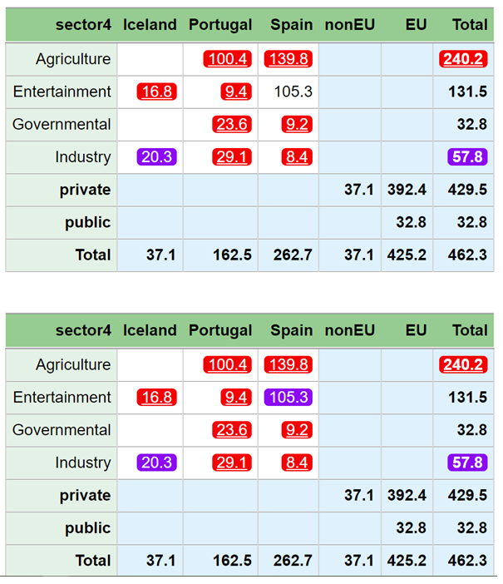
Only a single contributor
SuppressDominantCells(data=dataset,
numVar = "value",
formula = ~sector4*geo + sector2*eu,
contributorVar = "company",
n = 1:2, k = c(80, 99),
singletonMethod = "none")
SuppressDominantCells(data=dataset,
numVar = "value",
formula = ~sector4*geo + sector2*eu,
contributorVar = "company",
n = 1:2, k = c(80, 99),
singletonMethod = "none")
This single contributor can subtract its own value and recalculate Entertainment:Portugal, which is primary suppressed.
131.5 – 105.3 - 16.8 = 9.4
SuppressDominantCells(data=dataset,
numVar = "value",
formula = ~sector4*geo + sector2*eu,
contributorVar = "company",
n = 1:2, k = c(80, 99))
Only a single contributor
With default singletonMethod, such recalculation is impossible

Slide 12
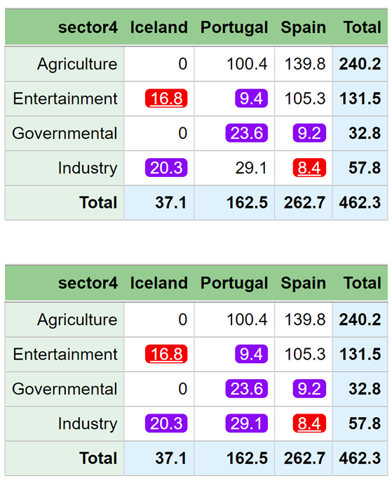
The previous GaussSuppression version
Here, Entertainment:Iceland can recalculate the value Industry:Spain, and vice versa.
Recalculation goes via a secondary suppressed value.
Therefore, implementing protection within an algorithm is challenging.
The current GaussSuppression version
With new default singletonMethod, such recalculation is impossible

Slide 13
The Singleton Problem
This strategy is utilized in Tau-Argus and in the previous version of GaussSuppression
The problem occurs when a single contributor, with knowledge of their own data, can use this information to deduce:
Primary suppressed cells
Or information from another contributor
A classical response to this issue involves
Creating specific suppressed cells before running the secondary algorithm
This addresses many of the concerns
Newer method
The issue is treated as a part of the Gauss algorithm
This solution resolves nearly all problems
The effectiveness depends on the algorithm's complexity
This is the approach in the current version of GaussSuppression

Slide 14
Practical Considerations
Trust in the automation
It's possible to experiment with setting singletonMethod = "none"
To evaluate its impact
Various singletonMethod alternatives are available
Maybe worth trying out ….
See NEWS ..

Slide 15
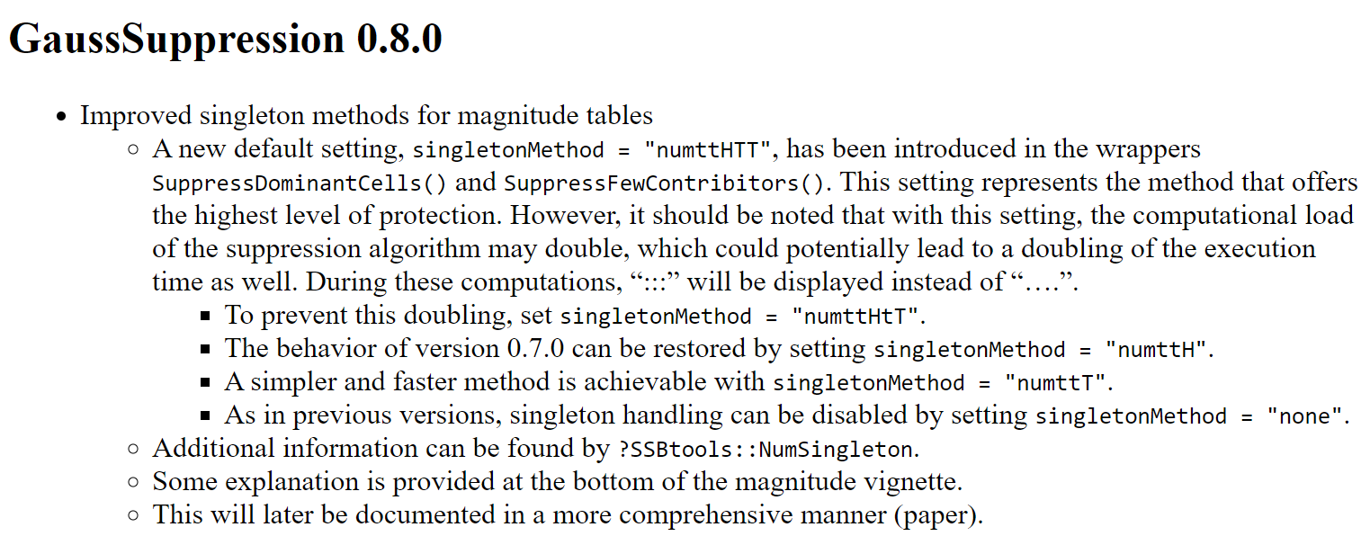
See more details in NEWS on CRAN
https://cran.r-project.org/web/packages/GaussSuppression/news/news.html

Slide 16
The so-called singleton problem

Slide 17


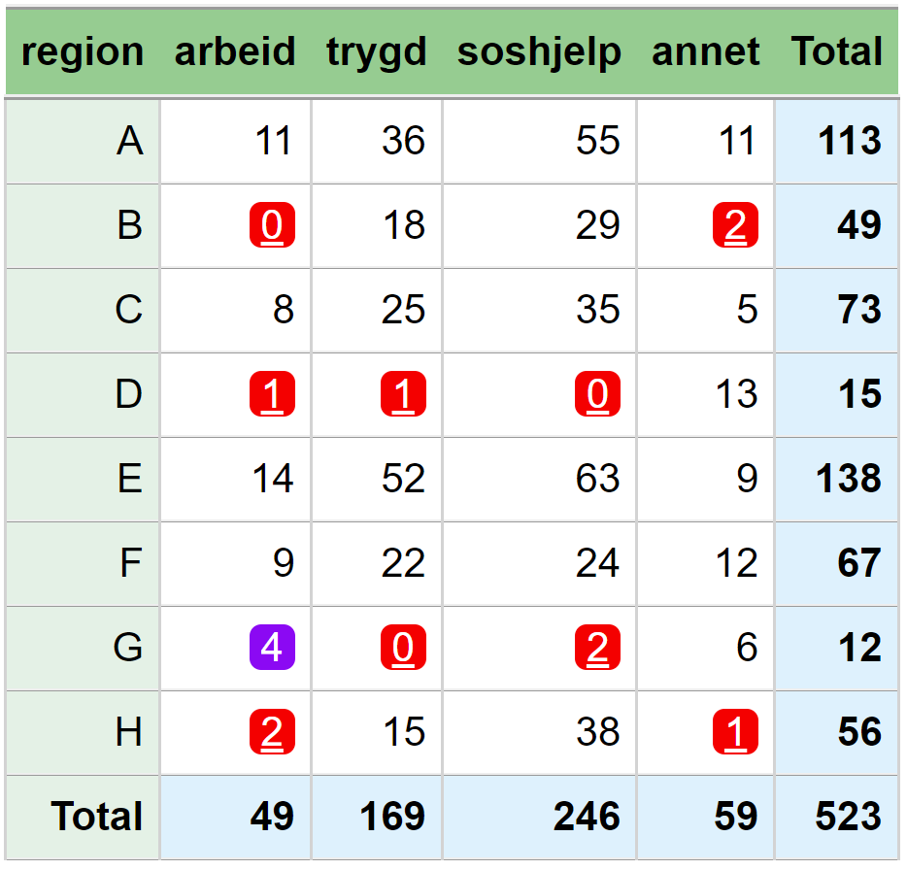
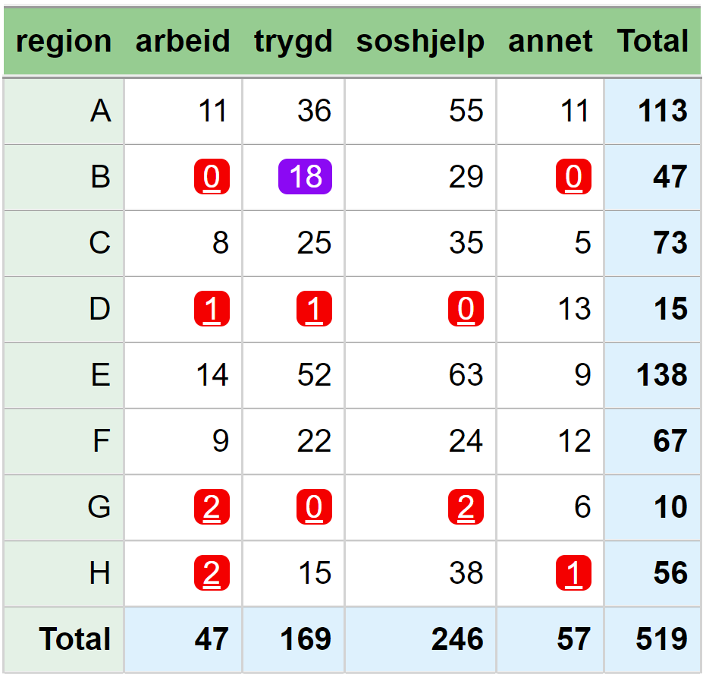



Secondary suppression is needed Do you see why?
This is repetition from exercises on day 1.
Easy to seed that suppressed values in region B must be 0. The sum of non-suppressed values equals the row total.
59-11-5-13-9-12-6 = 3
(49+56) - 3 - (29+38) - (15+18) = 2
49 - 2 -11-8-14-9-4 = 1

Slide 18
Does Gauss see that secondary suppression is needed?
This problem is not easy for the Gauss algorithm
Because a matrix within the algorithm does not have information about frequency values
The algorithm needs auxiliary information
The term singleton is used for this
This problem is easy for the Gauss algorithm
That secondary suppression is needed here is just as easily seen as any other need for secondary suppression

Slide 19
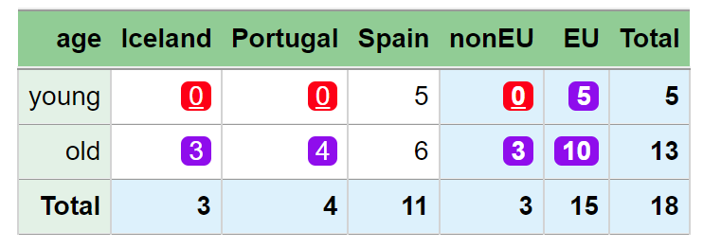
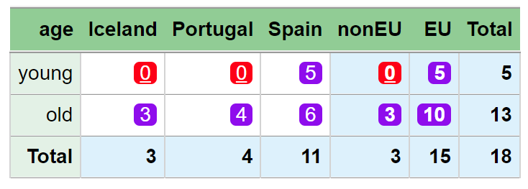
The so-called singleton problem with 0’s
SuppressSmallCounts(data = dataset_b,
dimVar = c("age", "geo", "eu"),
freqVar = "freq",
maxN = 2,
singletonMethod = "none")
Easy to seed that the primary suppressed values must be 0.
SuppressSmallCounts(data = dataset_b,
dimVar = c("age", "geo", "eu"),
freqVar = "freq",
maxN = 2)
The default, which is singletonMethod = "anySum", works well and solves the problem.

Slide 20
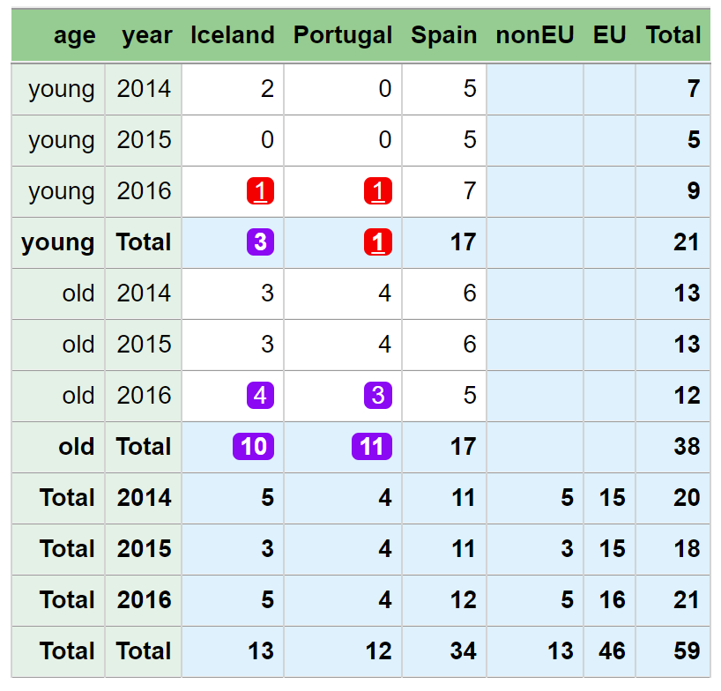
The so-called singleton problem with 1’s
SuppressSmallCounts(data = dataset,
formula = ~age*geo*year + eu*year,
freqVar = "freq",
maxN = 1,
protectZeros = FALSE,
singletonMethod = "none")
One can see that the primary suppressed values in the young:2016 row must be 1, since none of the values can be 0.
The problem occurs when zeros are never suppressed
protectZeros = FALSE
secondaryZeros = FALSE (default)

Slide 21
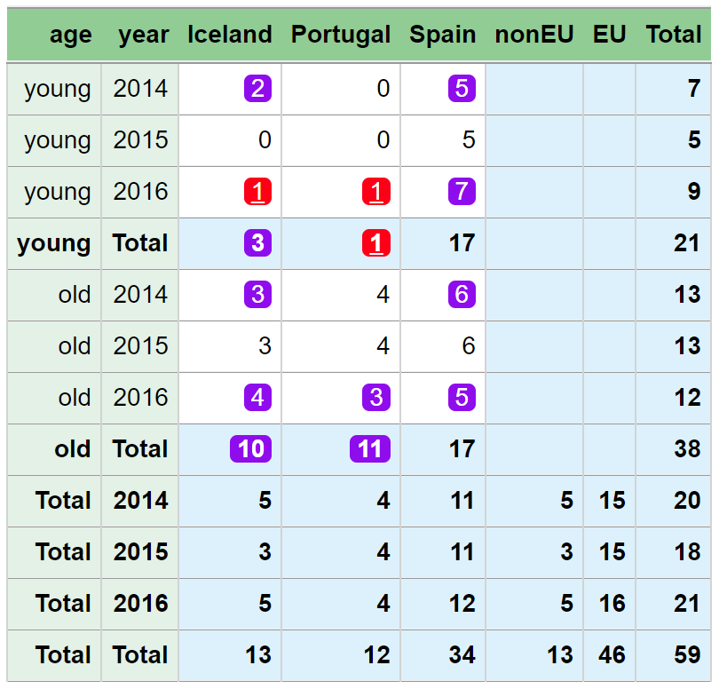
The so-called singleton problem with 1’s
SuppressSmallCounts(data = dataset,
formula = ~age*geo*year + eu*year,
freqVar = "freq",
maxN = 1,
protectZeros = FALSE)
The problem occurs when zeros are never suppressed
protectZeros = FALSE
secondaryZeros = FALSE (default)
The default, which is singletonMethod = "anySum", works well and solves the problem.

Slide 22
Control of secondary cells with weightVar frekvens

Slide 23
How are secondary cells chosen?
The Gauss algorithm uses a priority order
In SuppressSmallCounts, low frequency values are preferred for secondary cells
In SuppressDominantCells and SuppressFewContributors, small values of the (first) numVar are preferred for secondary cells
This priority order can be manipulated with the weightVar parameter
Thus, it is the weighted frequencies that control the order
NOTE: Exactly how the weightVar parameter works will likely be changed. This is to ensure that “all weights=1” always yield the same result as without using the parameter.

Slide 24
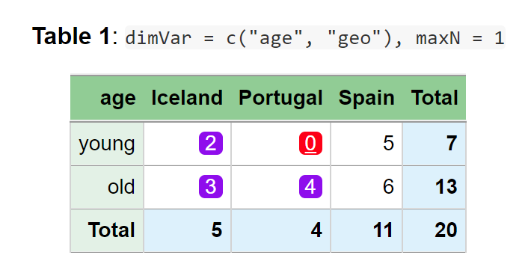
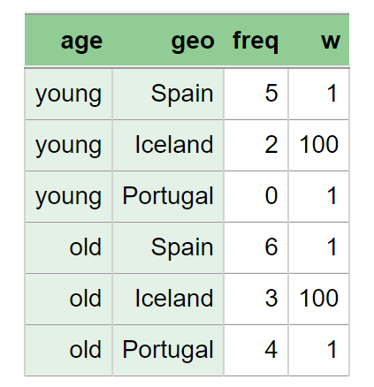
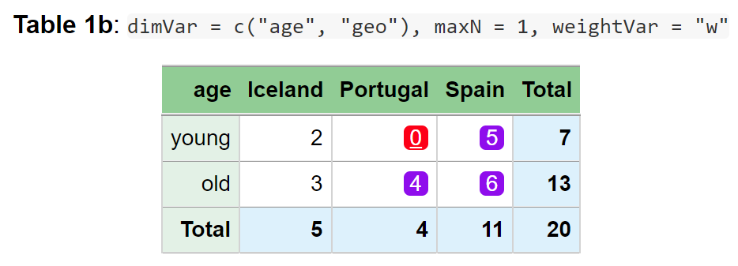
Output from ordinary SuppressSmallCounts
We add a weight variable to the data, to give Iceland extra weight
Using weightVar, Spain is suppressed instead of Iceland, since Iceland is most important.

Slide 25
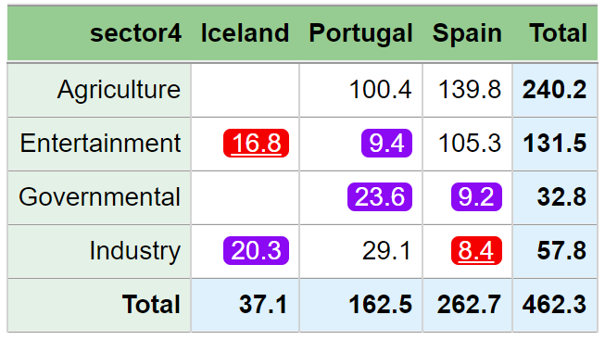
> SuppressDominantCells(data = dataset,
numVar = "value",
formula = ~sector4*geo,
n = 1, k = 99,
contributorVar = "company")
Output from ordinary SuppressDominantCells

Slide 26
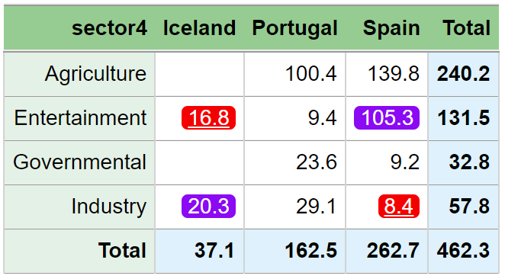
> dataset[["w"]] <- 1
> dataset[dataset[["geo"]] == "Spain", "w"] <- 0.0001
>
> SuppressDominantCells(data = dataset,
numVar = "value",
formula = ~sector4*geo,
n = 1, k = 99,
contributorVar = "company“
weightVar = "w")
Here, we have given Spain less weight, so that Spain become secondary suprresed

Slide 27
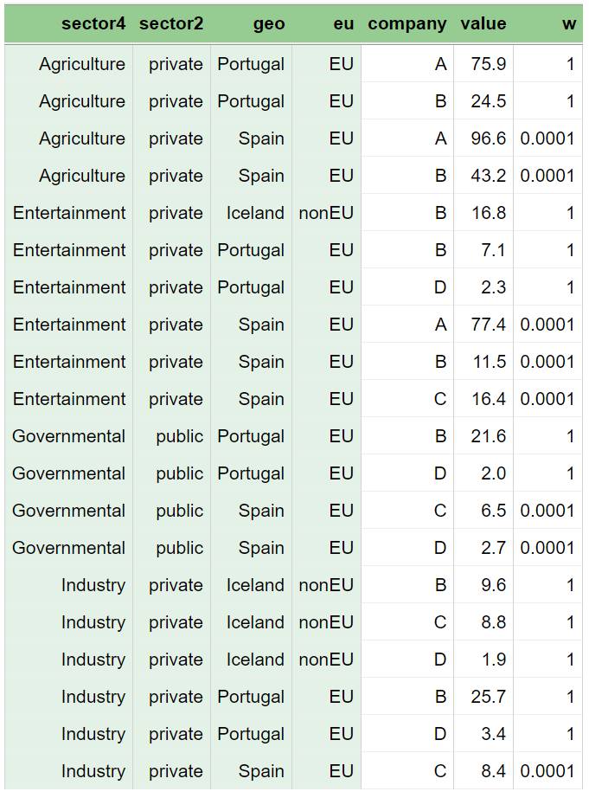
Here is the data and the two results

Slide 28
Exercises
exercises/singleton.md
Direct link:
https://github.com/statisticsnorway/kurs-metode-sdc-2024/blob/main/exercises/singleton.md

